Slide 1
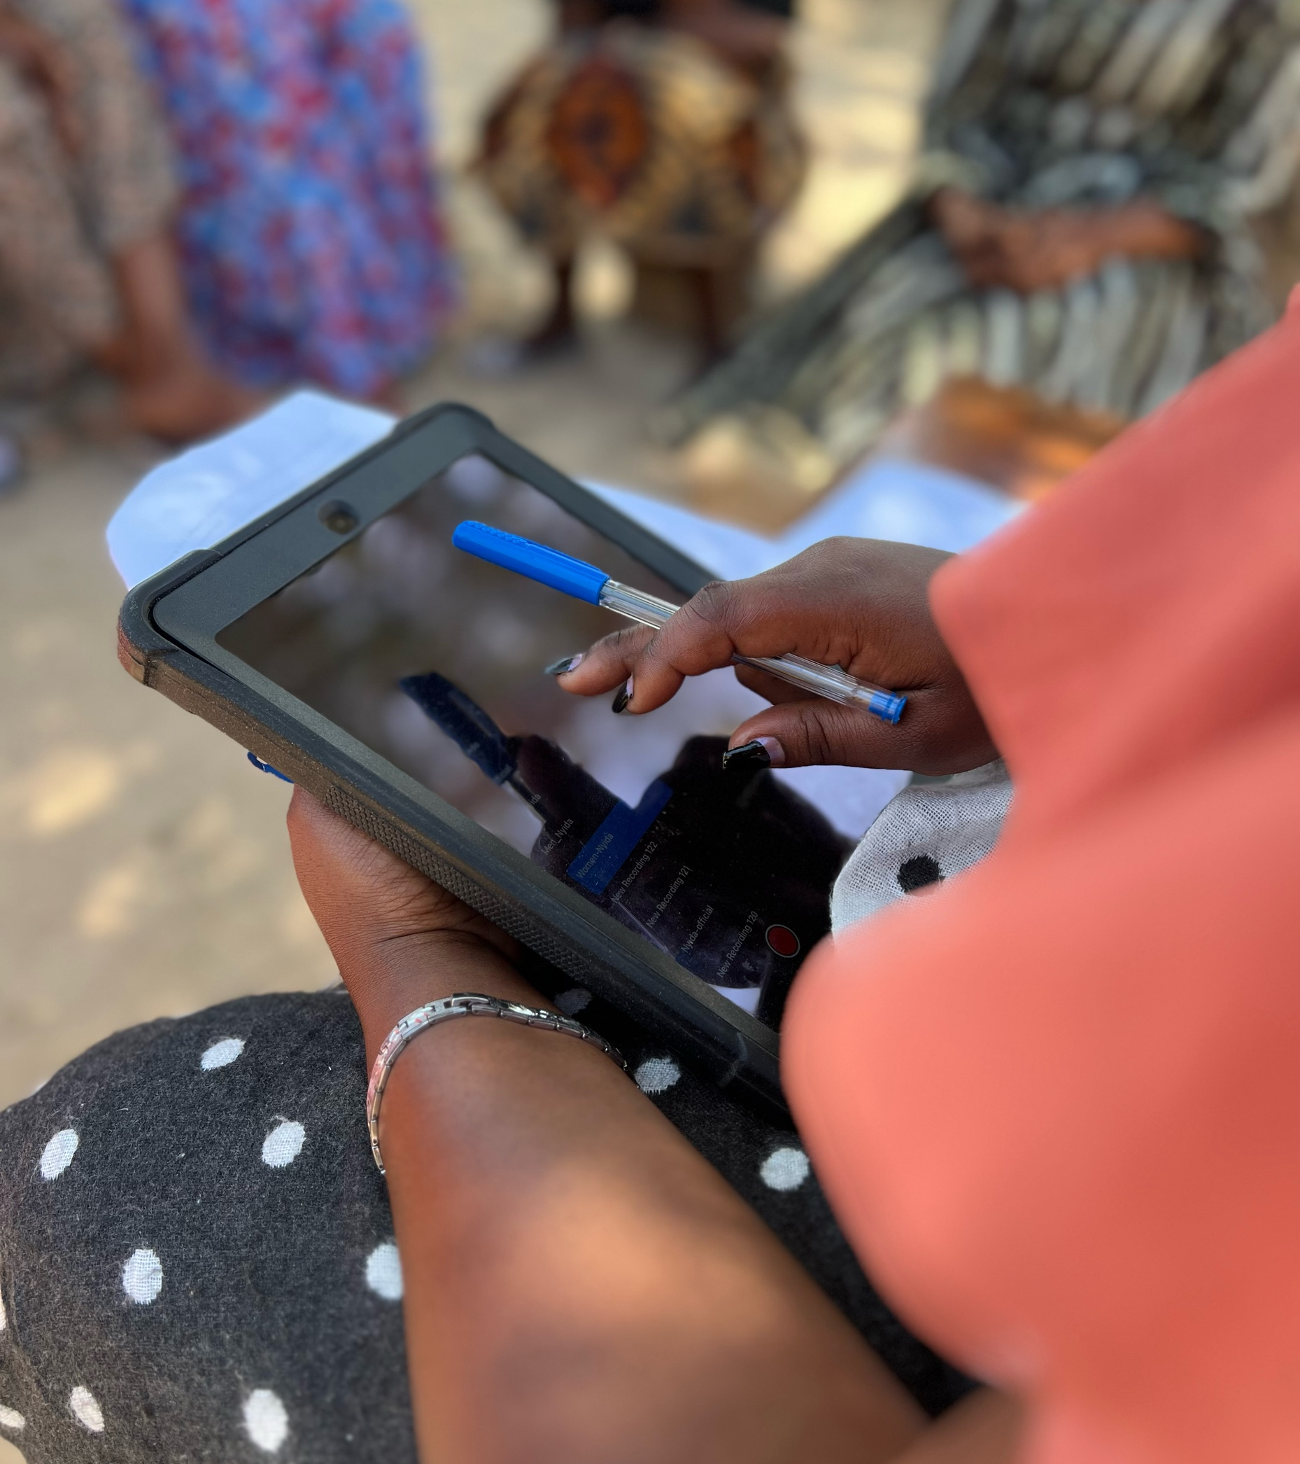
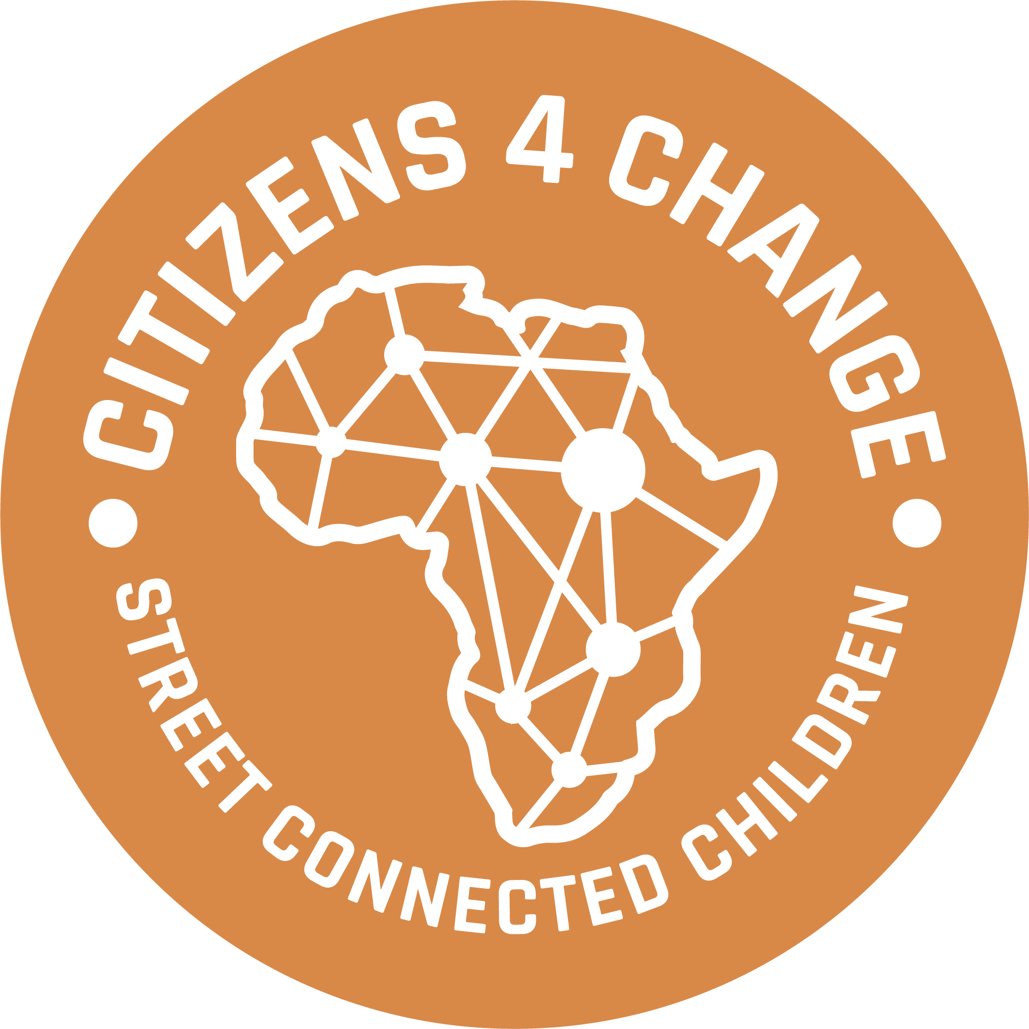
Moving from precarity to security: Empowering Street-Connected Youth to access Livelihood Opportunities through Youth Associations Railway Children Africa - Baseline Assessment 2023

Slide 5
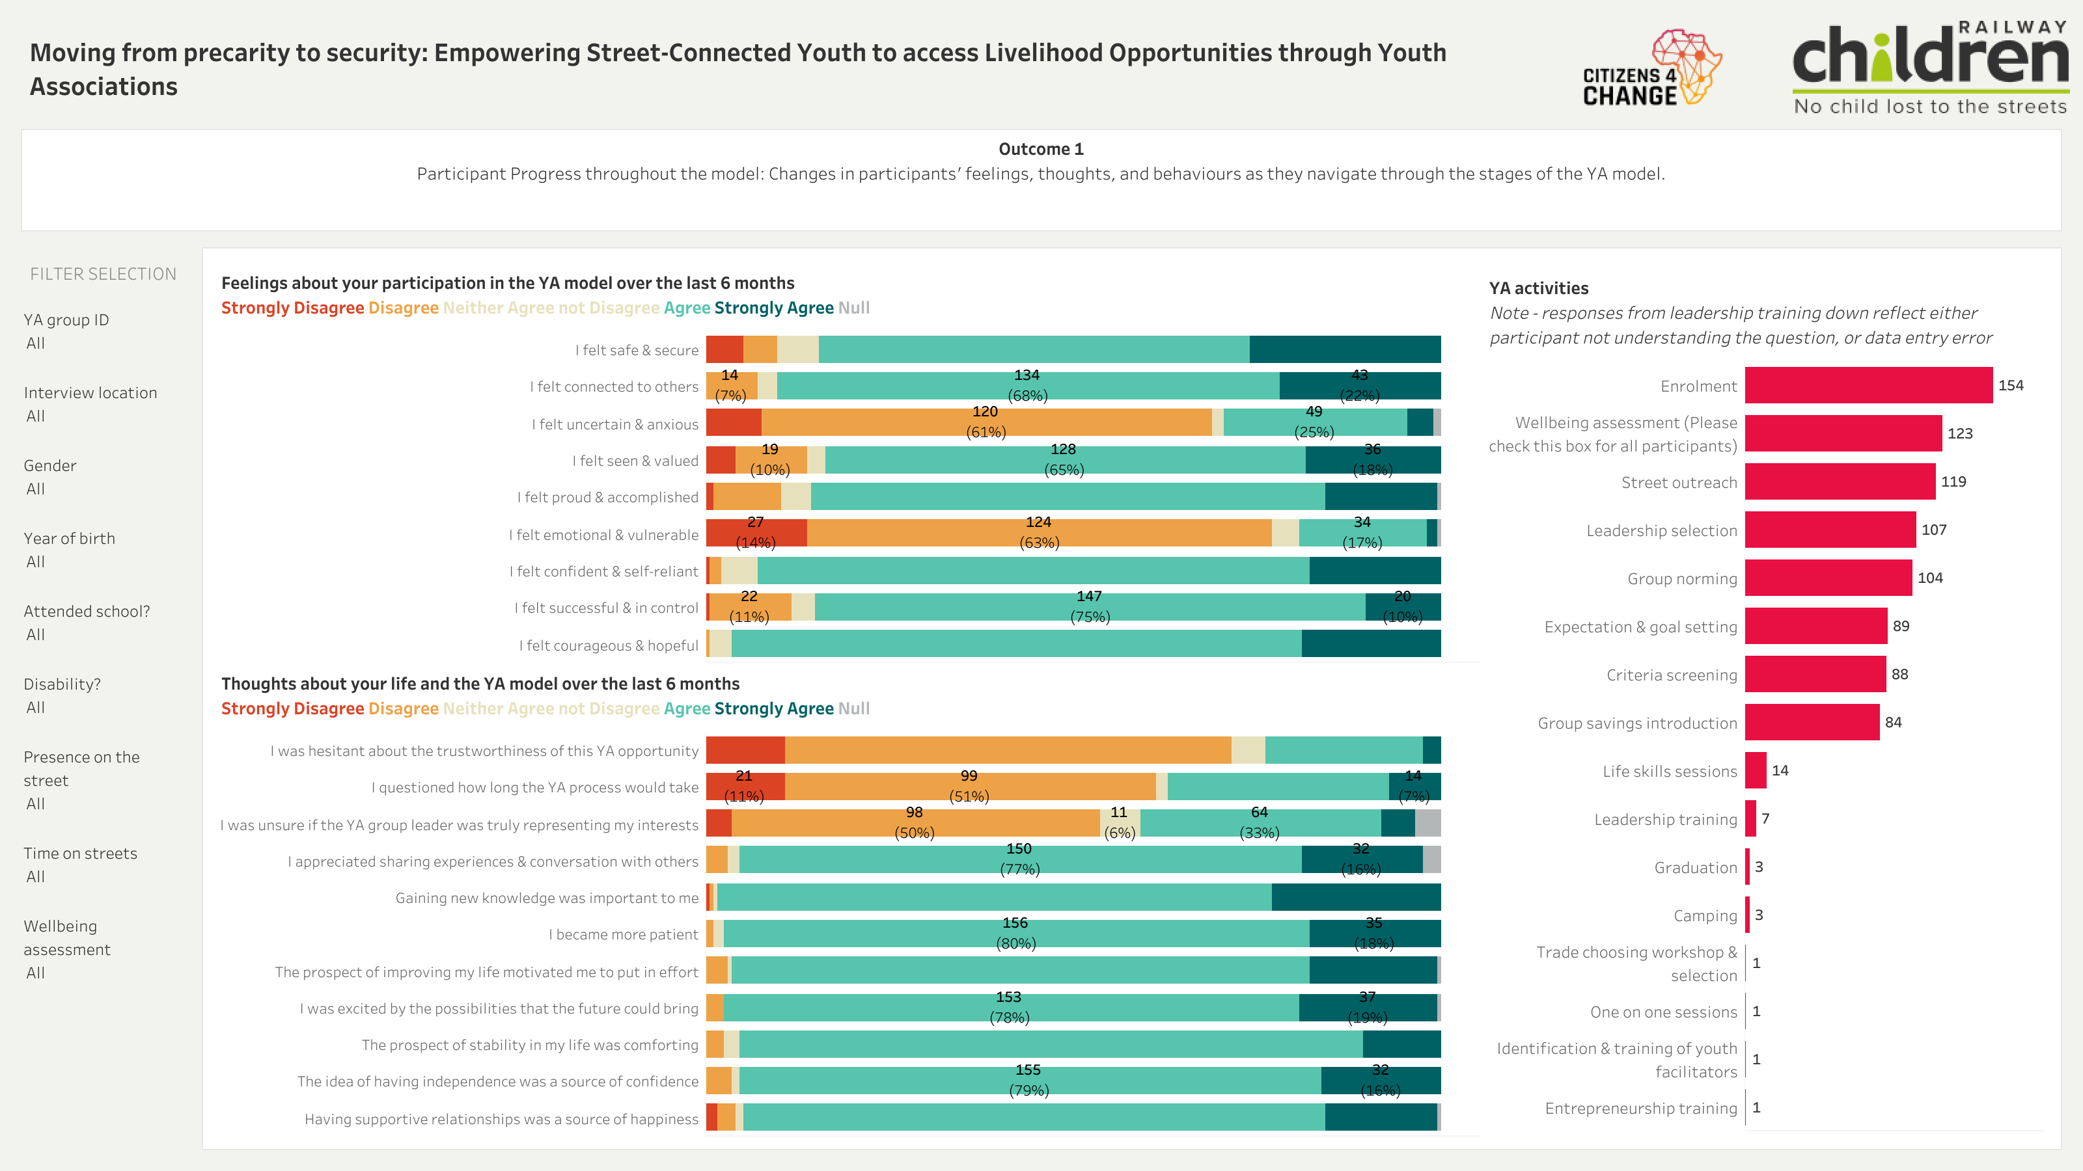

Slide 7
